Slide 1
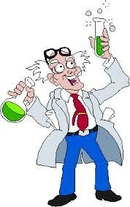

Chemical Kinetics

Slide 2
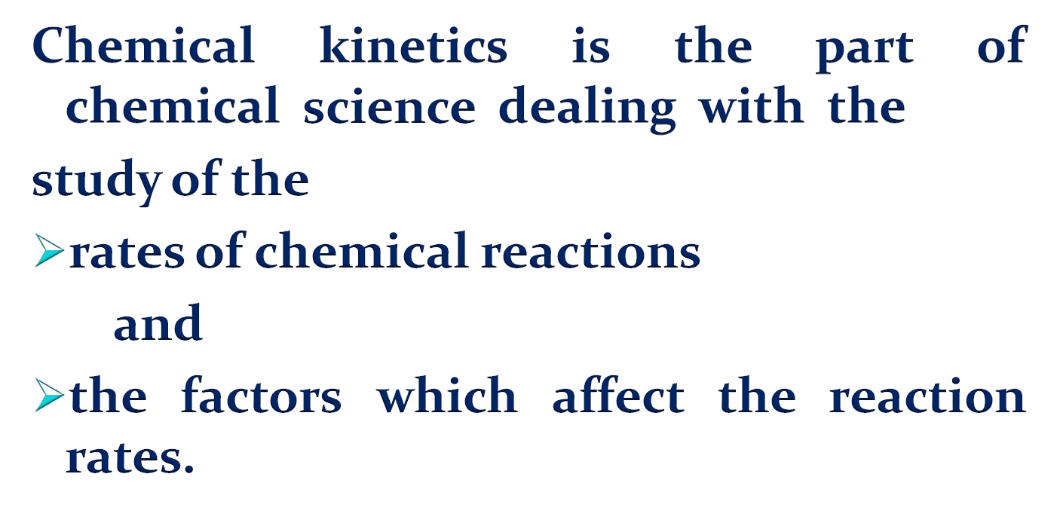
What is chemical kinetics

Slide 3
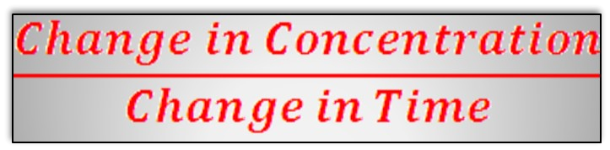
Reaction Rates
Rate of a chemical reaction = change in concentration (mol/L) of a reactant or product with time (s, min, hr);
Rate of Reaction=

Slide 4

Chemical Kinetics
A
B
Δ[A] = change in concentration of A over time period Δt
Δ[B] = change in concentration of B over time period Δt
Because [A] decreases with time, Δ[A] is negative.
rate = - ^{Δ[A]}
Δt
Δ[B]
Δt
rate =

Slide 5

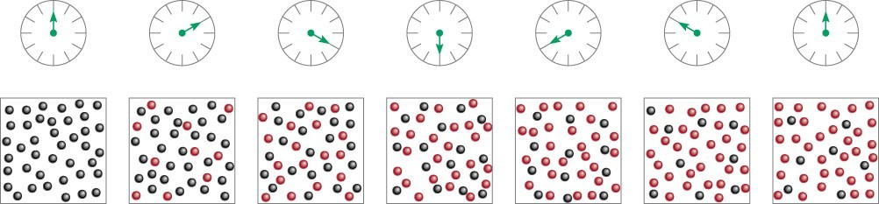
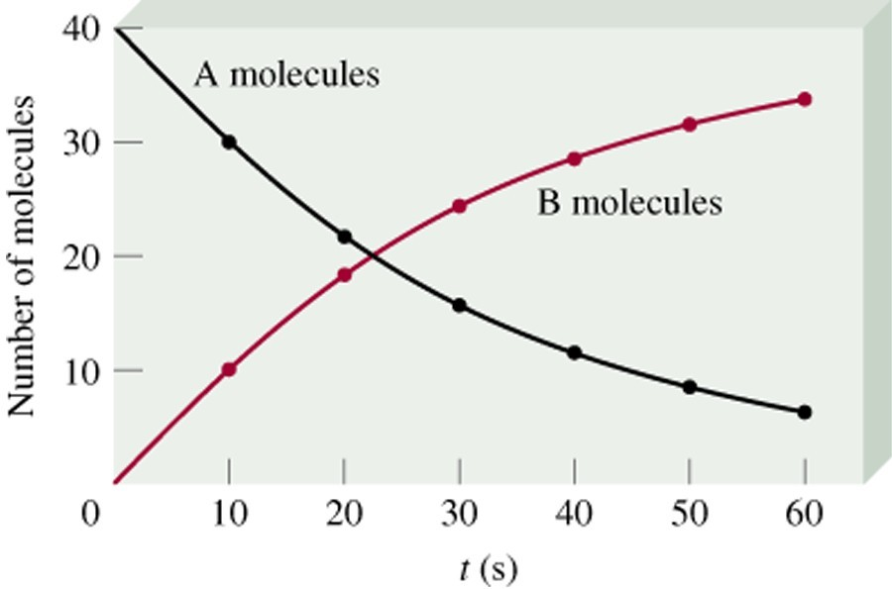
A
B
time
rate = - ^{Δ[A]}
Δt
Δ[B]
Δt
rate =
13.1

Slide 6


We know how to work out the rate of reaction …
That’s where the rate expression comes in
… but that doesn’t tell us if the all the reactants make the same contribution to the overall reaction
Look at this reaction …
X + Y → Z
Or X may make no contribution
X may make more contribution to the rate of the reaction than Y
The only way to find this out is through experimentation
to the rate of the reaction – instead it depends on Y

Slide 7

[HCl]
When you see square brackets around a formula it means concentration of
… means concentration of HCl
So, we could say that the rate is proportional to the concentrations of the reactants …
rate ∝ [X][Y]

Slide 8
This suggests that X and Y both have an equal affect on the rate of this reaction
rate ∝ [X][Y]
Question …
What would happen if we double the concentration of X or Y?
Question …
What would happen if we had [Y]²?
The rate of reaction would also double
Doubling the concentration of Y would quadruple the reaction rate

Slide 9



k is the symbol for the rate constant
Unfortunately, proportionality signs aren’t very useful to us, so we need to replace it with a constant …
rate = k[X][Y]
k is different for every reaction
k varies with temperature so temperature must be stated when quoting k

Slide 10



Let’s look at the rate equation for X and Y again …
rate = k[X][Y]²
… means that Y has double the effect of X on the rate of reaction
This is the order with respect to Y
The overall reaction order of X + Y is …
1 + 2
3rd order
X must have an order of 1
[X] and [X]¹ are the same

Slide 11
So, taking into account the rate constant and the reaction order, the overall rate expression is …
rate = k[X]^{m}[Y]^{n}
… where m and n are the orders of the reaction with respect to X and Y
The overall reaction order is m + n

Slide 12

The order can be determined experimentally using the initial rate method, but …
… to do so, the concentration of the reactant under investigation should be changed – the other reactant’s concentration should remain the same
[A]
The initial rate method
involves plotting the data obtained from an experiment and using the tangent from time 0 to calculate the rate
time

Slide 13

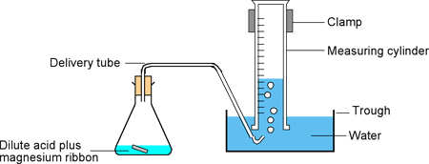



If rate doubles because the concentration is doubled, then it is a first order reaction
[X] mol dm⁻³ | [Y] mol dm⁻³ | Rate mol dm⁻³ s⁻¹
0.01 | 0.02 | 0.0004
0.01 | 0.04 | 0.0008
Since the rate is doubled when [Y] is doubled the order with respect to Y is 1
Note: we don’t know the order of X and would have to do another experiment to find out
Concentratio n remains the same
Rate of reaction doubled
Concentratio n doubled

Slide 14

Let’s add another result …
Question …
[X] mol dm⁻³ | [Y] mol dm⁻³ | Rate mol dm⁻³ s⁻¹
0.01 | 0.02 | 0.0004
0.01 | 0.04 | 0.0008
0.005 | 0.04 | 0.0004
What is the order of X?
1
So, the overall rate equation is … rate = k[X][Y]
Question …
What is the value of the rate constant?
_{k =} rate
0.0004
0.01 x 0.04
=
= 1.0 mol⁻¹ dm⁻³ s⁻¹
[X][Y]

Slide 15
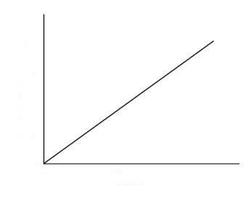
If the concentrations are not simple whole numbers, then it may be easier to draw a graph of rate against concentration
A first order reaction will be a straight line through 0
Rate
The gradient in this case is the rate constant (k)
Concentration

Slide 16






Question …
[X] mol dm⁻³ | [Y] mol dm⁻³ | Rate mol dm⁻³ s⁻¹
0.01 | 0.02 | 0.0004
0.01 | 0.04 | 0.0016
What is the order of Y?
Order of reaction with respect to Y is 2
Concentratio n remains the same
Rate of reaction quadrupled
Concentratio n doubled
Question …
Question …
What is rate equation?
What is the order of X?
3
rate = k[X]³[Y]²
0.02
0.02
0.0032

Slide 17
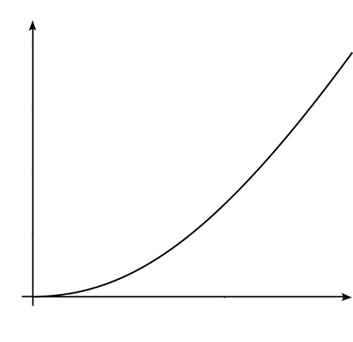
In this case the rate is [X]², giving a curve through the origin
Rate
Concentration

Slide 18

Question …
[X] mol dm⁻³ | [Y] mol dm⁻³ | Rate mol dm⁻³ s⁻¹
0.2 | 0.1 | 0.0004
0.4 | 0.1 | 0.0008
0.8 | 0.2 | 0.0064
What is the order of X?
1
We cannot work out Y straight away – instead let’s look at the
whole reaction …
Question …
Both reactant concentrations have doubled …
… the reaction rate has increased by x8
3
What is the overall reaction rate?
So, the order of reaction with respect to Y is …
= 2
overall order = X order + Y order

Slide 19

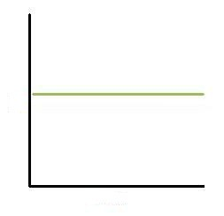
Rate
In a zero order reaction you get a straight line as concentration does not change with rate
In this case the rate = rate constant
Concentration
This means the reactant has no influence over the rate of reaction

Slide 20

The units of the rate constant (k) vary depending on the order of the reaction …
First order reaction
…
rate = k[A]
mol dm⁻³ s⁻¹
= k x mol dm⁻³
rate (mol dm⁻³ s⁻¹)
[A] (mol dm⁻³)
_{s}-1
= k
Second order reaction
…
rate = k[A][B]
mol dm⁻³ s⁻¹
= k x mol dm⁻³ x mol dm⁻³
rate (mol dm⁻³ s⁻¹)
[A] & [B] (mol dm⁻³)
mol⁻¹ dm³ s⁻¹ = k

Slide 21
Question …
What about this reaction?
rate = k[A][B]²
rate (mol dm⁻³ s⁻¹)
Remember, the units of k vary depending on the order of the reactants
(mol dm⁻³)
(mol dm⁻³)²
mol dm⁻³ s⁻¹
= k x mol dm⁻³ x mol dm⁻³ x mol dm⁻³
k = mol⁻² dm⁶ s⁻¹

Slide 22


As a rule when the temperature increases so does the rate
Generally, for every 10ºC increase the rate doubles
Look at the following rate equation …
rate = k[A][B]
Question …
IIffweeininccrreeaasseetthhee teemmppeerraattureeooffA or B wwhhaatthhaappppeenns tto tthhee ccoonncceenntrraattioionn??
Therefore, the temperature only affects k
Nothing

Slide 23
Because k varies with temperature it can be used to compare the same reaction at different temperatures
Question …
Temperatu Rate re Constant
(K) (mol⁻¹ dm³ s⁻
1₎
What can we deduce from the table?
633 0.0178 x 10⁻³
666 0.107 x 10⁻³
As temperature increases so does the value of k
697 0.501 x 10⁻³
715 1.05 x 10⁻³
15.1 x 10⁻³
781
This only works if the concentration of the reactants remains the same

Slide 24

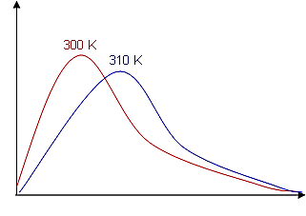

Remember, temperature is a measure of the average kinetic energy
Paarrttiiclees wiill onnlly rreeaacct iif tthheeyycolliiddeeaannddhhaavvee eennougghheenergy ttoossttaarrtt brreeaakiing bbonnddss..
Thhiisseenneerrggyyis known aass…
activation energy (E_{a})
Only the particles above E_{a} will react
Particles with
energy
Notice there are more particles above E_{a} at the higher temperature
Energy
E_{a}

Slide 25
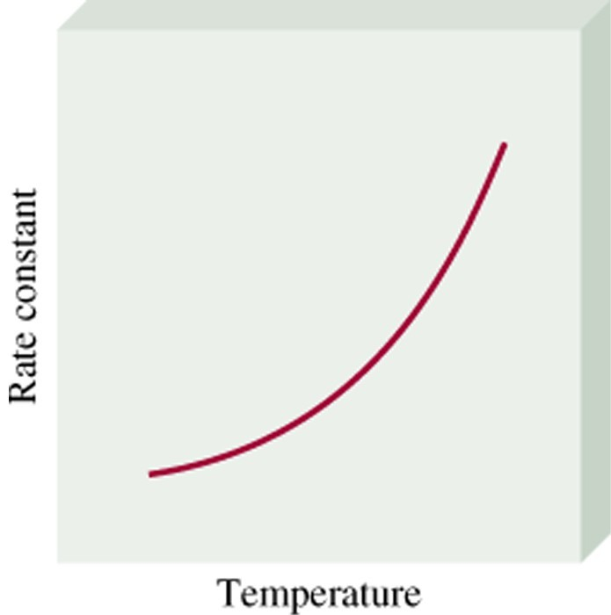
Temperature Dependence of the Rate Constant
k = A • exp( -E_{a}/RT ) (Arrhenius equation)
E_{a} is the activation energy (J/mol)
R is the gas constant (8.314 J/K•mol)
T is the absolute temperature
A is the frequency factor
lnk = - ^{Ea 1} + lnA R T
13.4

Slide 26
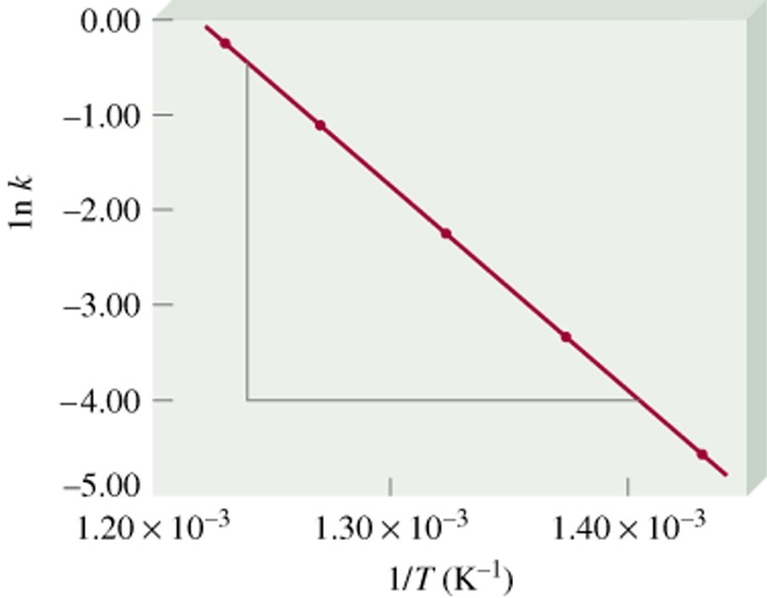
lnk = - ^{Ea}
1
+ lnA
R T
13.4

Slide 27

For any reaction to occur -
Molecules must collide with each other.
once molecules collide they may react together or they may not -
Molecules must have sufficient energy, and
Molecules must have correct geometry. O₃(g) + NO(g) → O₂(g) + NO₂(g)
O=O-O + NO → [O=O-O⋅⋅⋅⋅⋅ NO] → O=O(g) + ONO(g) √
O=O-O + ON → [O=O-O⋅⋅⋅⋅⋅ ON] → O=O(g) + OON(g)

Slide 28

energy barrier to the reaction
amount of energy needed to convert reactants into the activated complex
·
the activated complex is a chemical species with partially broken and partially formed bonds
○ always very high in energy because of partial bonds
28

Slide 29
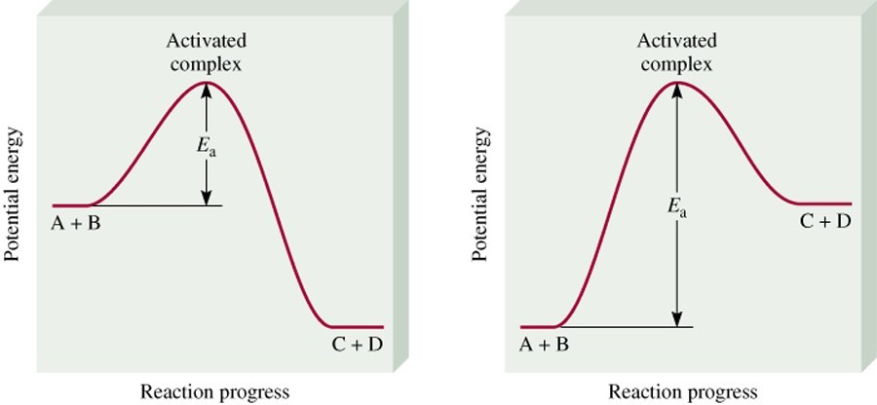
C + D
A + B
Exothermic Reaction
Endothermic Reaction
The activation energy (E_{a}) is the minimum amount of energy required to initiate a chemical reaction.
13.4

Slide 30
Reaction Mechanisms
The overall progress of a chemical reaction can be represented at the molecular level by a series of simple elementary steps or elementary reactions.
The sequence of elementary steps that leads to product formation is the reaction mechanism.
2NO (g) + O₂ (g) 2NO₂ (g)
N₂O₂ is detected during the reaction!
Elementary step:
+ Elementary step:
NO + NO N₂O₂ + O₂
N₂O₂ 2NO₂
Overall reaction:
2NO + O₂
2NO₂
13.5

Slide 31
Intermediates are species that appear in a reaction
mechanism but not in the overall balanced equation.
An intermediate is always formed in an early elementary step and consumed in a later elementary step.
Elementary step:
+ Elementary step:
NO + NO N₂O₂ + O₂
N₂O₂ 2NO₂
Overall reaction: 2NO + O₂ 2NO₂
The molecularity of a reaction is the number of molecules reacting in an elementary step.
•
•
•
Unimolecular reaction – elementary step with 1 molecule Bimolecular reaction – elementary step with 2 molecules Termolecular reaction – elementary step with 3 molecules
13.5

Slide 32

Temperature Concentration Pressure Surface area
Presence of a catalyst
·
·
·
·
·

Slide 33

Increase in temp. → increase in KE → increase in no. of collisions + increase in no. of particles with greater than required amount of activation energy
→ more particles react → increase rate of reaction
·

Slide 34

Can you explain why food should be kept in deep-freeze compartments in order to ensure its freshness?
·
·
(answer on next slide)

Slide 35
Answer:
The low temperature slows down chemical reactions which makes the food turn bad.
·
·

Slide 36

High concentration/pressure → more particles per unit volume → increase in frequency of collisions → rate of reaction increases
·

Slide 37

Increase in surface area/particle size → increase in exposure to the other reactant → increase in probability of collisions → increase in rate of reaction
·

Slide 38

Speeds up rate of reaction through lowering activation energy needed for reaction to occur
Think: What can you infer from the above statement?
·
·

Slide 39

·
Learn through understanding, not through memorization.

